Slide 1

Working with Pastors data

Slide 2
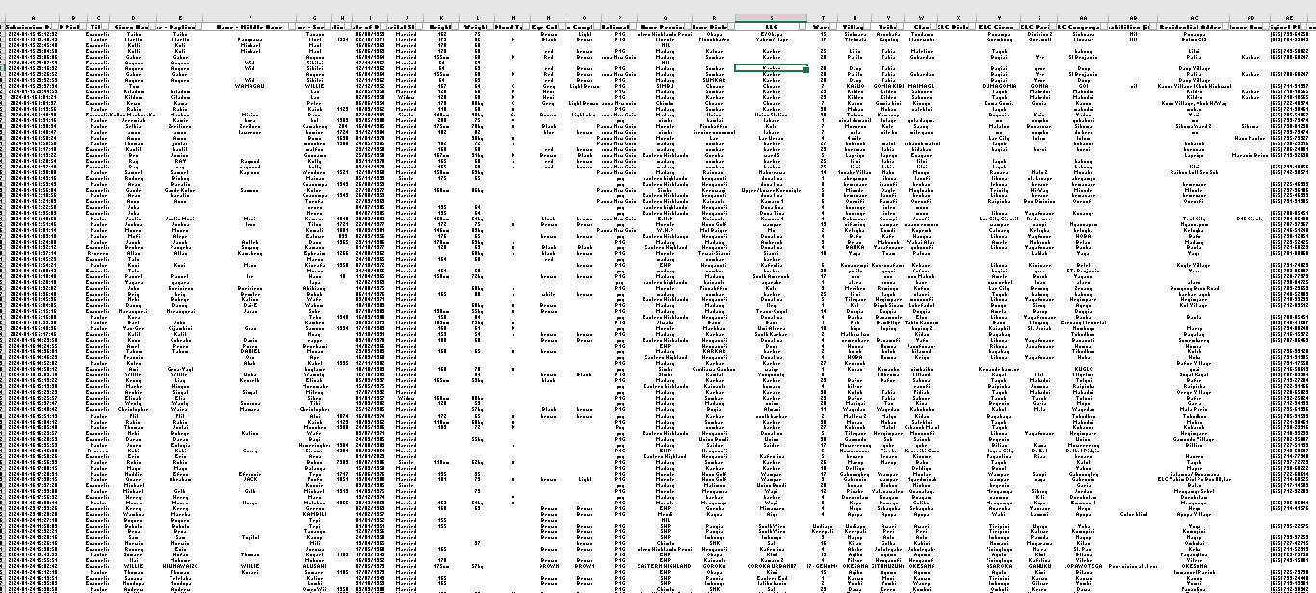

What we had in the past until now
Height: from 40 to 300 cm
Weight: from 30 to 162 Kg
Date of birth: from 9/16/1918 to 10/9/2024, many born on 1st of January
Great mismatch of data, not usable for real business
Date of birth | Count
1001-01-01 | 24
1069-01-01 | 1
1900-01-01 | 1
1900-01-01 | 3

Slide 3
What we need
'Evangelistelist',
'EVANGELSIT',
'EVANGLIST',
'Evegelism',
'Envangelist',
'Evan.',
'Evangalist',
'Evangelism',
'evangelist',
'Evengelist',
'Evn',
'evn',
'Evagelist',
'Evagelism',
'Evangelis',
'EVANGELIST',
'Evangelist',
'Evegelist',
'Evengelis',
'Evengelis'
Clear rules: one way to write Evangelist
Check of Data
Responsibility for Data
Responsibility for Reports and Queries

Slide 4
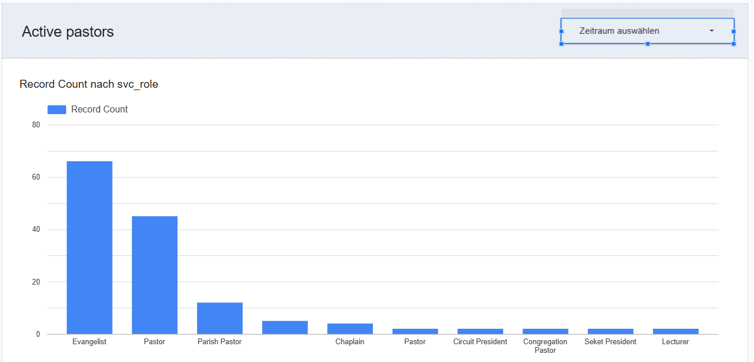
What we want to have in future
Predefined Reports for people who need it for their work
Information for Development of those Reports> What is needed?

